Slide 1
Data Collection
Data Partitioning
Data Augmentation
Data Segmentation
Testing
Model Creation
Training & Validation
CNN
Accuracy

Slide 2
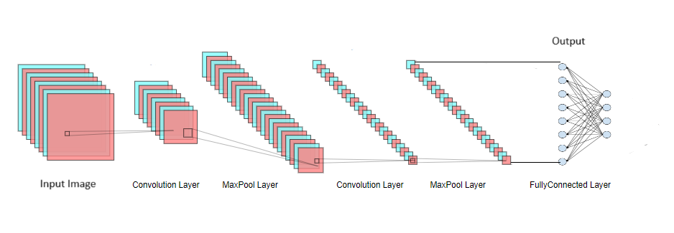
x3

Slide 3
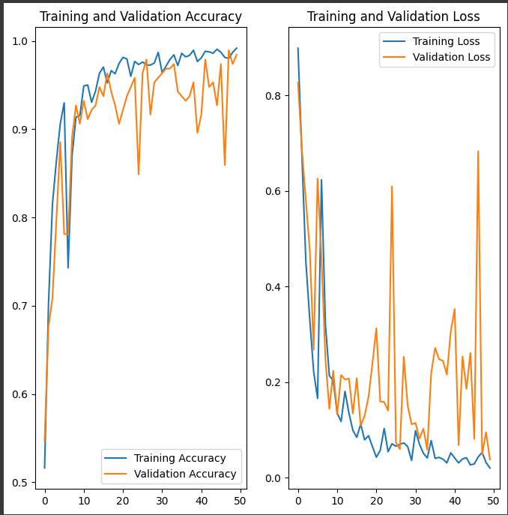

Slide 4
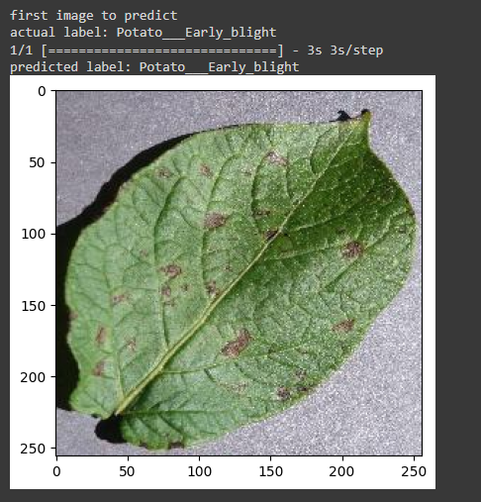

Slide 5
